Slide 1


Aurelia Wealth Intelligence
Turning synthetic multi-portfolio wealth data into explainable, client-specific decision support for Relationship Managers.

Slide 2
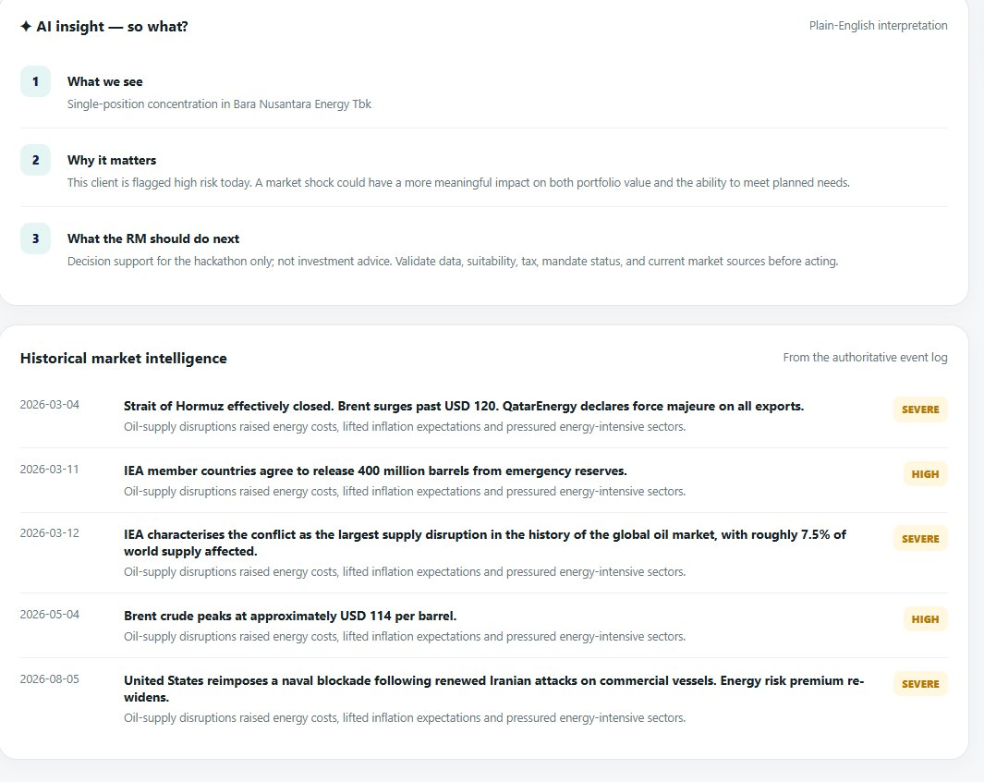
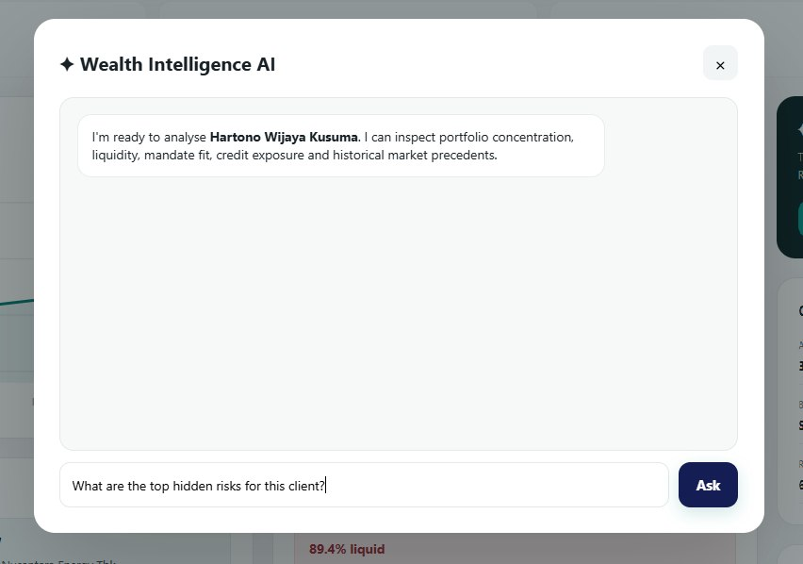
Recommendation System
Matches and recommends suitable financial products tailored to each client's specific risk profile, liquidity constraints, and investment objectives.

Slide 3
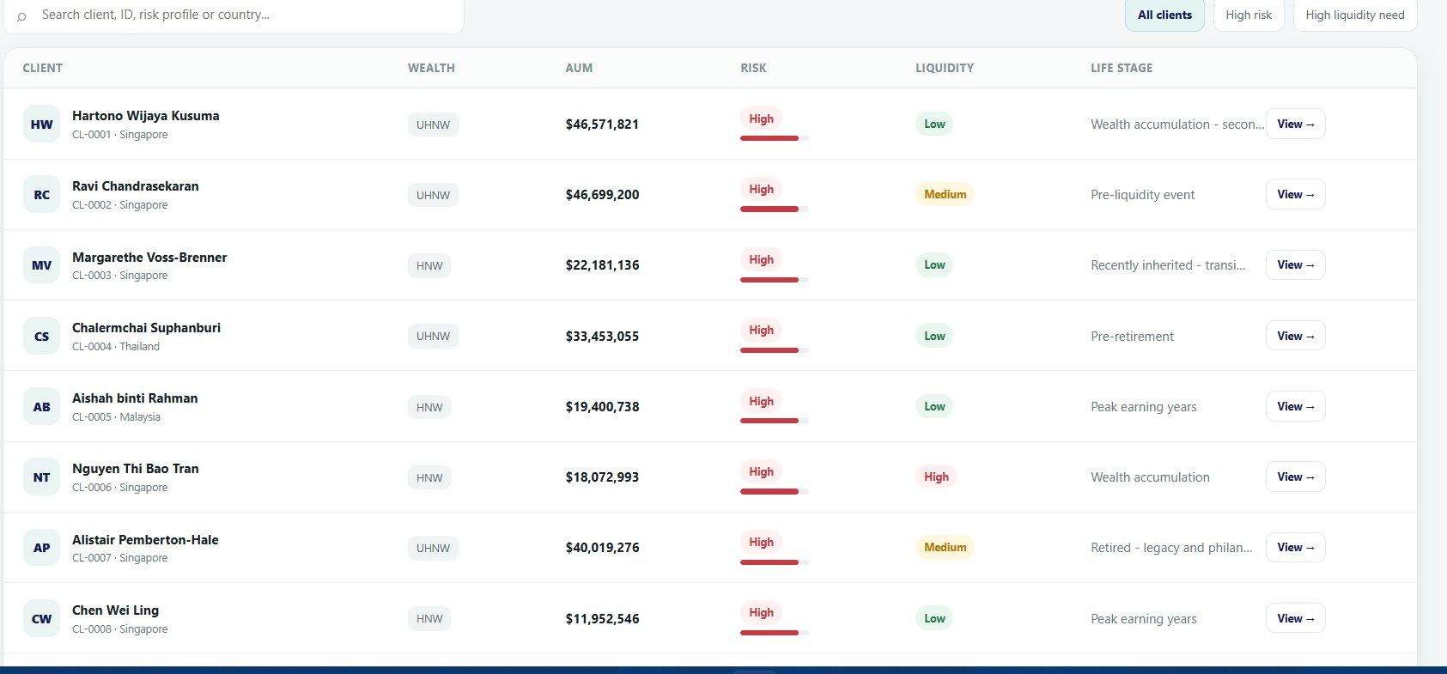
Prioritization System
Ranks detected client signals and portfolio gaps by financial urgency so Relationship Managers instantly target the highest-impact accounts.

Slide 4
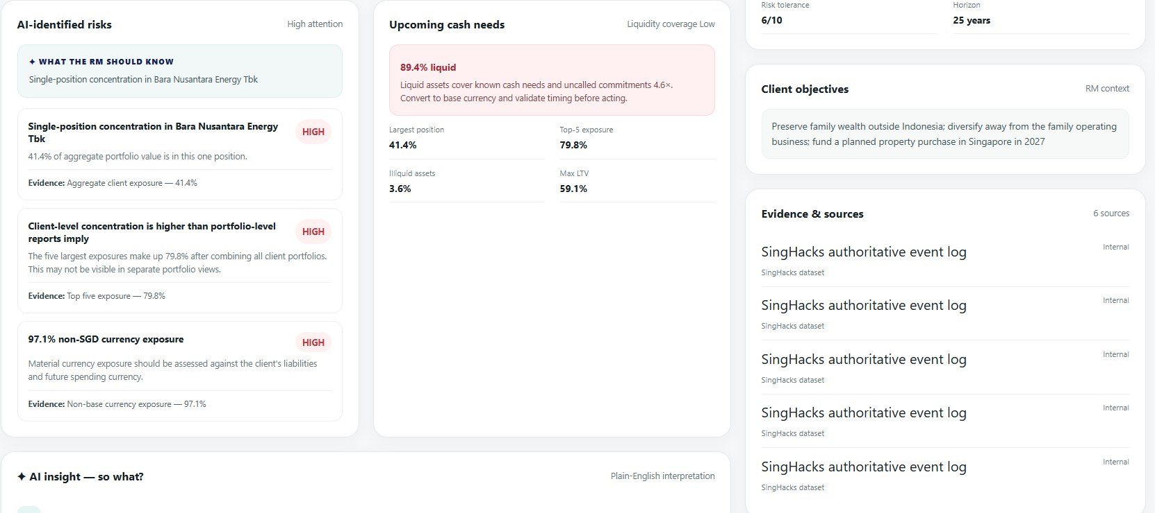
Risk Agent System
Scans aggregated multi-portfolio assets to dynamically surface hidden concentration, leverage, currency, and liquidity risks with 100% deterministic precision.

Slide 5
Scenario Analysis Agent System
Stress-tests client portfolios and proposed product allocations against historical market shocks (event_log.csv) to validate downside resilience before pitching.

